Slide 1
Alexa Online Ethnography
Konstantinos, Husain, Gerard

Slide 2
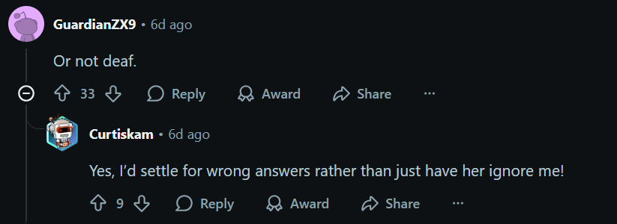
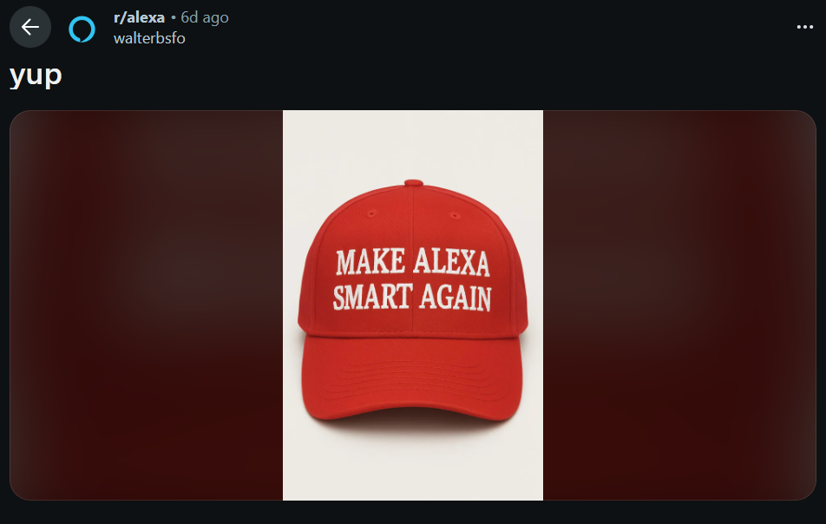

Ranting Against Alexa

Slide 3
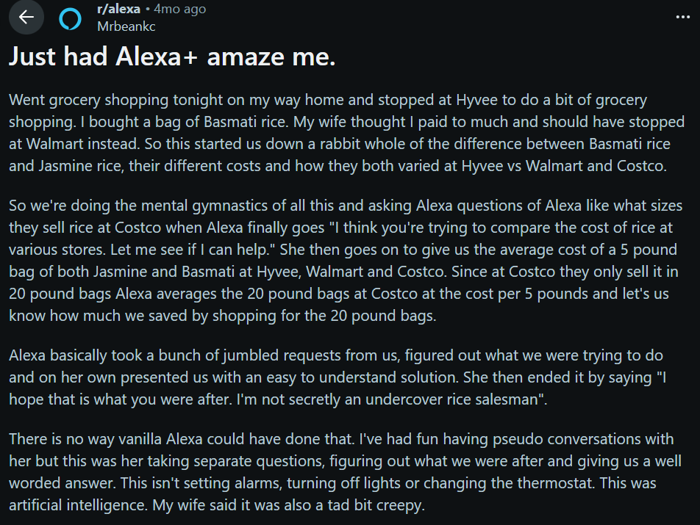

Enjoying Alexa

Slide 4
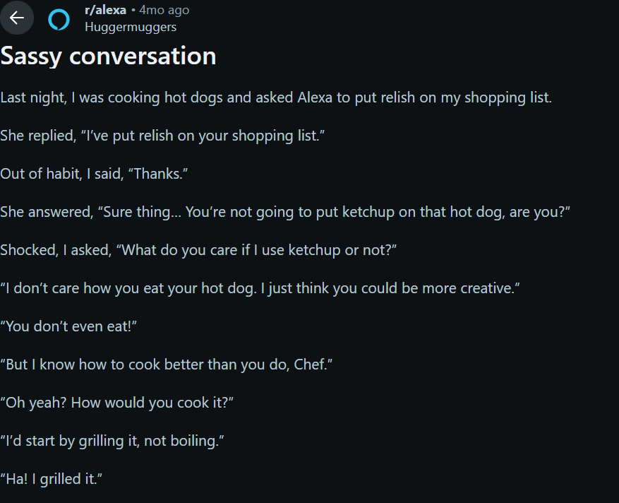
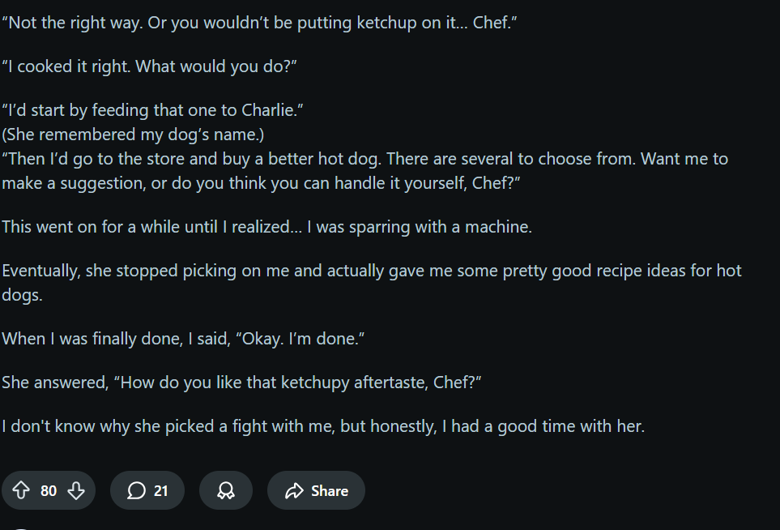
Funny Interaction

